Slide 1
3D Scanner Project Defense
Project Supervisor:
Prof. Yohan Fougerolle
Cansen Jiang

Slide 2
Team members:
Yu LIU
Chunxia LI
Anirudh PULIGANDLA
Darja STOEVA
Gopikrishna ERABATI
Hassan ZAAL
Avinash NARAYANA
Shubham WAGH
Ziyang HONG
AbdelRahman ABUBAKR

Slide 3
Outline
Problem statement
Introduction
Project management
Technical parts
Qt classes
Turning table
Conclusion

Slide 4
Problem Statement
3D Scanners are quite proficient today and have become familiar in our everyday lives.
They are not restricted to only academic and industrial applications.
Aim : To make a home-made acquisition and processing software generating accurate 3D models using off-the-shelf Kinect v2 camera.

Slide 5
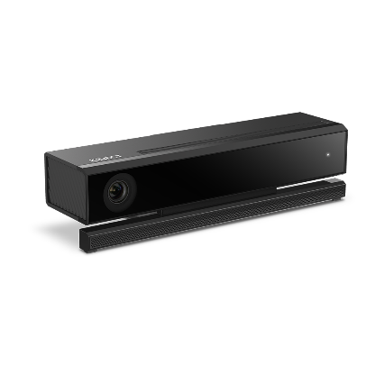
Introduction
Implementation of fully-functional 3D scanning software outputting watertight triangulation meshes
Targets home-made and quick scanning (acquisition time less than 90 seconds)
Stationary Kinect V2 for depth data acquisition
Available Point Cloud Library used as the main resource for depth data processing

Slide 6
Project Management
Internal Organization :
Scanning Team – interfacing Kinect v2, grabbing PCD frames, registration.
Meshing Team – normal estimation, upsampling, meshing techniques, mesh smoothing.
GUI Team – QVTK widgets, user friendly interface designing.
Hardware Team – rotating turntable construction, serial communication .

Slide 7
Project Management
Weekly Meetings & Reports:
Several meetings and conversations with the tutors (October – December).
Weekly meetings with the members of the group.
Weekly report submissions.
Feedbacks on weekly reports by the tutors.

Slide 8
Project Management
Initial weeks, Meshing team concentrated 30% of the original work on meshing methods and 70% of the work to support Scanning team.
Later weeks, Scanning team concentrated 30% of the original work on registration methods (improvising results) and 70% of the work to support Scanning team.

Slide 9
Scanning
Kinect v2 :
Time-of-flight sensor technology.
Higher depth fidelity.
Improved 3D visualization.
Improved ability to see smaller objects and all objects more clearly.

Slide 10
Scanning
Kinect v2 Interfacing :
PCL doesn’t have grabber for input data from Kinect v2. (OpenNI does not provide any support).
Kinect2Grabber - Grabber to input data from Kinect v2 based on only Kinect SDK v2.
Callback function is defined.
Returns shared pointer of point cloud to outside.
Real-time display of point cloud is retrieved.

Slide 11
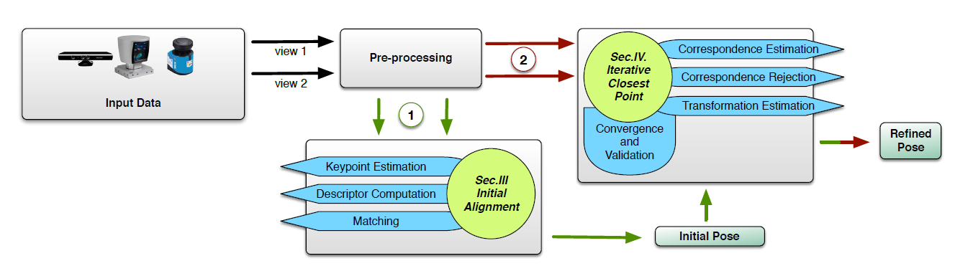
Registration Pipeline
Notes:
Brief overview of our registration pipeline, including Segmentation, Matching, Aligning
Can mention why we did not consider Features
11

Slide 12
Registration Pipeline
Notes:
Brief overview of our registration pipeline, including Segmentation, Matching, Aligning
Can mention why we did not consider Features
12

Slide 13
Preprocessing – Pass-Through Filter
Segmentation using pass-through filter (X, Y, and Z directions)
Significantly reduces number of points to be processed
pcl::PassThrough<PointT> pass;
pass.setInputCloud (CloudIn);
pass.setFilterFieldName ("z");
pass.setFilterLimits (ZLow , ZHigh);
pass.filter (*CloudFilteredZ);
Notes:
Show images before and after passthroughfilters for comparison
Psedo code snippet
13

Slide 14
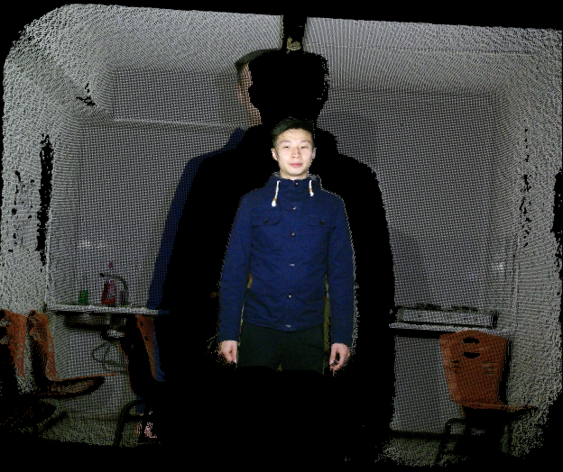
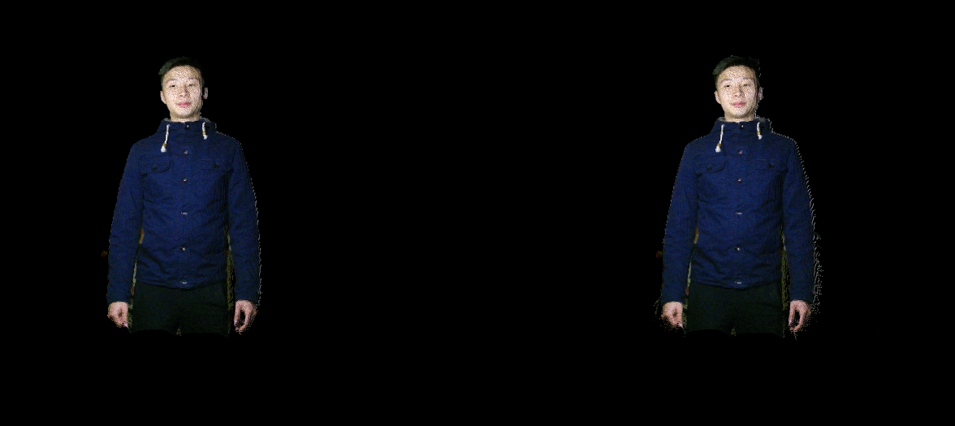
Preprocessing – Pass-Through Filter
Notes:
Show images before and after passthroughfilters for comparison
Psedo code snippet
14

Slide 15
Preprocessing – Outlier Removal
Target sparse points significantly far away from the main cluster
Statistical outlier filter (analysis on each point’s neighbor)
pcl::StatisticalOutlierRemoval<PointT> sor;
sor.setInputCloud (CloudIn);
sor.setMeanK (NumNeighbor);
sor.setStddevMulThresh (Threshold);
sor.filter (* CloudFilteredZ);
Notes:
Show images before and after statistical outlier removal for comparison
Psedo code snippet
measurement errors lead to sparse outliers which corrupt the results even more. This complicates the estimation of local point cloud characteristics such as surface normal which in turn might cause point cloud registration failures
distribution of point to neighbors distances in the input dataset
standard deviation multiplier to 1. What this means is that all points who have a distance larger than 1 standard deviation of the mean distance
For each point, we compute the mean distance from it to all its neighbors. By assuming that the resulted distribution is Gaussian with a mean and a standard deviation, all points whose mean distances are outside an interval defined by the global distances mean and standard deviation can be considered as outliers and trimmed from the dataset.
15

Slide 16
Preprocessing – Outlier Removal

Slide 17
Downsample
Further reduction of number of points
Voxel grid filter (approximation using centroid in a grid)
Reduce processing time for ICP
pcl::VoxelGrid<PointT> vox;
vox.setInputCloud (CloudIn);
vox.setLeafSize (LeafSize, LeafSize, LeafSize);
vox.filter (*CloudDownsampled);
Notes:
in each voxel (i.e., 3D box), all the points present will be approximated (i.e., downsampled) with their centroid. This approach is a bit slower than approximating them with the center of the voxel, but it represents the underlying surface more accurately.

Slide 18
Alignment – Iterative Closest Point (ICP)
Appropriate approach for data with rich overlaps
Standard ICP V.S. ICPwithNormals
One ICP V.S. Multiple ICPs
Notes:
if the clouds are
already roughly aligned, iterative registration provides efficient
and robust means to refine that initial guess and optimally align
the point clouds.
In order to speed up registration, another
common extension to the original ICP algorithm [2] is to
register only subsets of the input point clouds sampled in an
initial selection step.
18

Slide 19
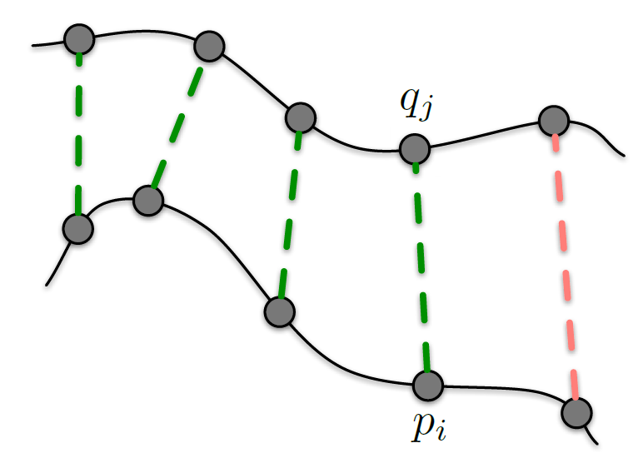
Correspondence Estimation
Searches for closest points between source and target points
False correspondence rejection based on distance criteria
Notes:
In the ICP algorithm by Besl and McKay [2] no feature descriptors
are computed, but instead closest points in Cartesian
space are considered to correspond to one another. A transformation
is estimated that minimizes the Euclidean distances
between found pairs of closest points in the least squares
sense. The process of determining corresponding points in the
two data sets and computing the transformation that aligns
them is iteratively repeated.
instead 1) search for closest points (matching step) and 2)
align the found point pairs (alignment step). These two steps
are repeated until convergence or until reaching another termination
criterion, thereby iteratively refining the alignment of
the source to the target point cloud
maximum
distance between corresponding points such that pairs with a
larger point-to-point distance are filtered out.

Slide 20
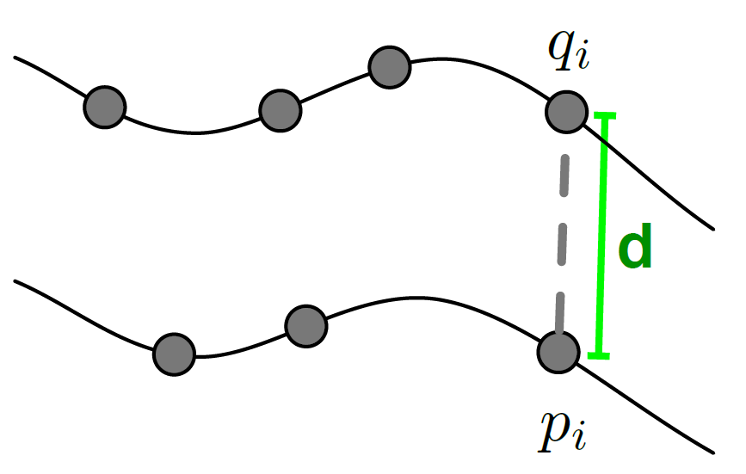
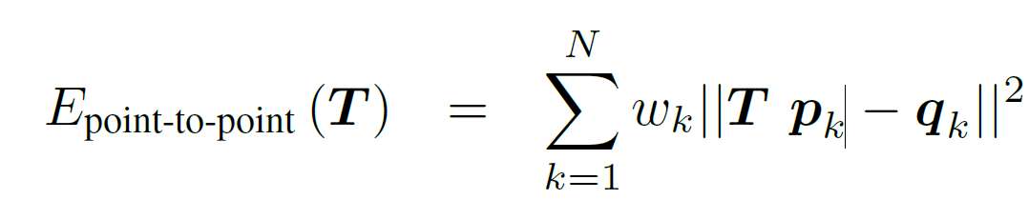
Standard ICP: Error Metric
Point-to-point Euclidean Distance
Notes:
It uses the distance between the source point pk and the
plane described by the target point qk and its local surface
normal nqk . Unlike the point-to-point metric

Slide 21
Standard ICP Code Snippet
PointCloud::Ptr ICP(PointCloud::Ptr src, PointCloud::Ptr tgt)
{
pcl::IterativeClosestPoint<PointT, PointT> icp;
icp.setMaxCorrespondenceDistance (MaxDistance);
icp.setTransformationEpsilon (1e-8);
icp.setMaximumIterations (Iterations);
icp.setInputSource(src);
icp.setInputTarget(tgt);
icp.align(*transformedSrc);
}
Notes:
Support sources saying ICPNormals is more robust
21

Slide 22
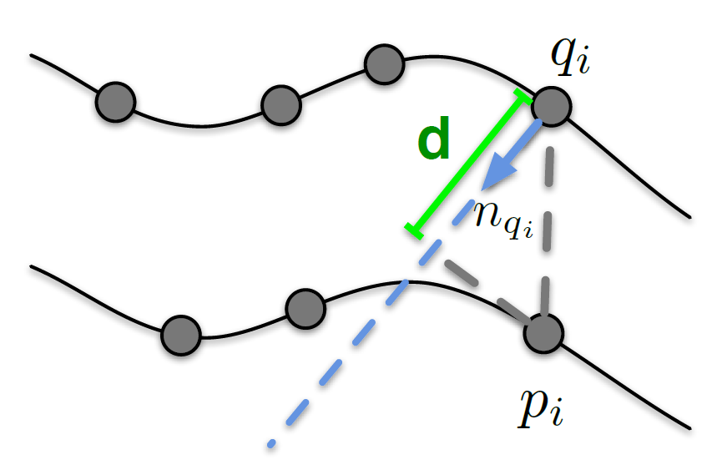
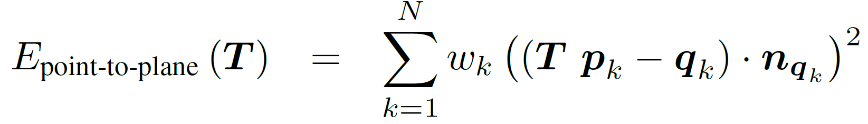
ICPwithNormals: Error Metric
Point-to-plane Euclidean Distance
Notes:
Support sources saying ICPNormals is more robust
a special case of IterativeClosestPoint, that uses a transformation estimated based on Point to Plane distances by default
22

Slide 23
ICP with Normals Code Snippet
PointCloud::Ptr ICPNormal(PointCloud::Ptr src, PointCloud::Ptr tgt) {
pcl::IterativeClosestPointWithNormals<PointNormalT, PointNormalT> icpn;
icpn.setMaxCorrespondenceDistance (MaxDistance);
icpn.setTransformationEpsilon (1e-8);
icpn.setMaximumIterations (Iterations);
icpn.setInputSource(src_with_normals);
icpn.setInputTarget(tgt_with_normals);
icpn.align(*transformed_src_with_normals);
Eigen::Matrix4f transform = icpn.getFinalTransformation ();
pcl::transformPointCloud (*src, * transformed_src, transform);
}
Notes:
Support sources saying ICPNormals is more robust
23

Slide 24
Incremental ICP-based Registration
Aligns
1
Aligns
Frame 1
Frame 2
Frame 3
Source Cloud
Target Cloud
Source Cloud
Target Cloud
Notes:
Flowchart
Light Downsample per registration to speed up the registration time, balance between details and processing time
Statistical outlier removal
24

Slide 25
Incremental ICP-based Registration
Frame 5
。。。
Frame N
Frame 4
1
Frame 3
Frame 1
Frame 2
Light downsampling in between for speed enhancement
Notes:
Flowchart
25

Slide 26
Alternative: Two ICPs in Sequence
First ICP for initial alignment in case of limited overlapping (looser false correspondence rejection criteria)
Second ICP for refining alignment (strict rejection criteria)
Notes:
Turning table stablizes
26

Slide 27
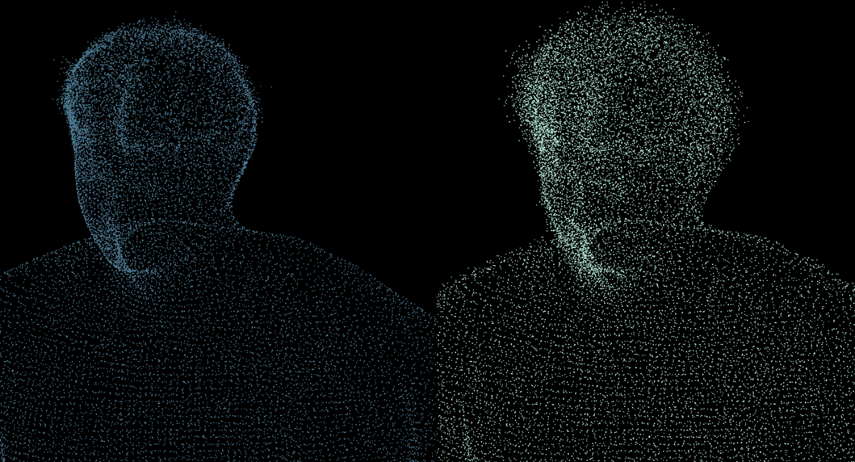
Smoothing
Moving least squares surface reconstruction smooths noisy data
Multi-layer to single surface
Crucial step for proper meshing
Notes:
Flowchart
27

Slide 28
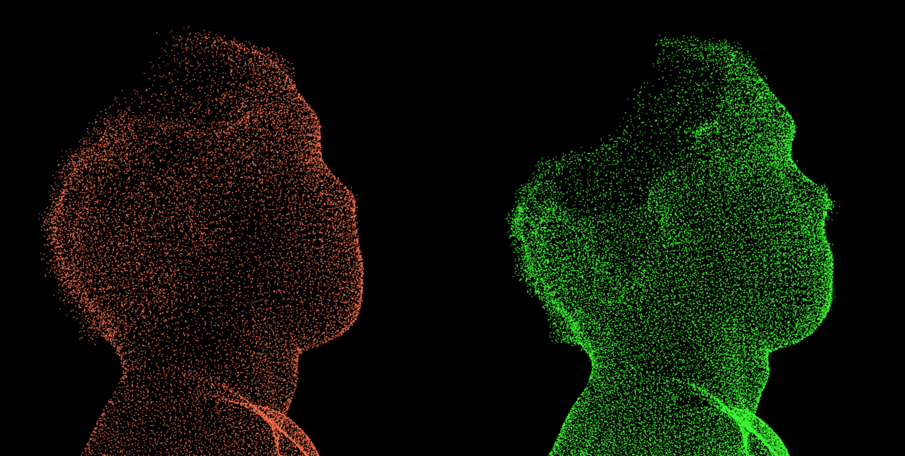
Smoothing – Noisy Data V.S. Details
Notes:
Flowchart
28

Slide 29
Greedy Projection Triangulation
For Reliability and accuracy of the mesh three topics are important:
Noise
Holes
Details

Slide 30
Meshing
A mesh can be grown and extended by maintaining the list of points until all possible points are connected
Works best until the surface is locally smooth
Computes all distances, sorts them and examines each pair of points in length and compatibility, then edges are created.

Slide 31
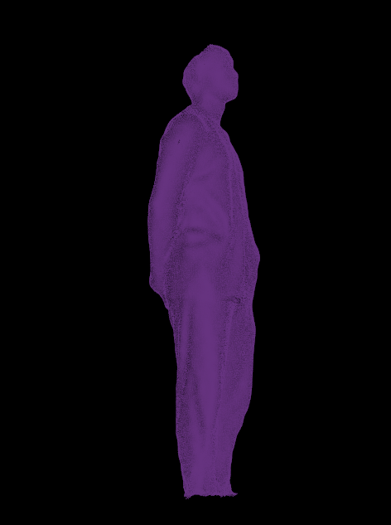
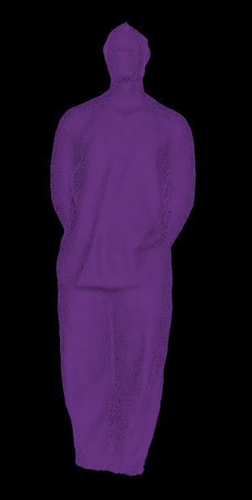
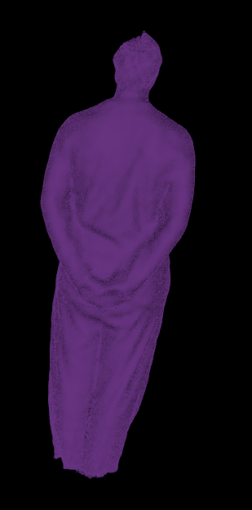
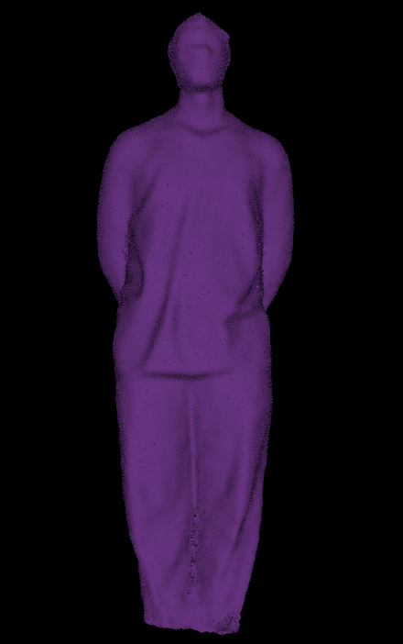
Greedy Projection Triangulation

Slide 32
Code snipet
pcl::GreedyProjectionTriangulation<pcl::PointNormal> gp3;
gp3.setMaximumNearestNeighbors (n); gp3.setMaximumSurfaceAngle(S max); gp3.setMinimumAngle(Min angle); gp3.setMaximumAngle(Max angle); gp3.setNormalConsistency(Boolean);

Slide 33
Grid Projection
The algorithm tries to create surfaces that lacks boundaries and proper orientation
Works best for largest meshes(Flat) and with out too much noise.
It creates continues surface unlike greedy projection triangulation.

Slide 34
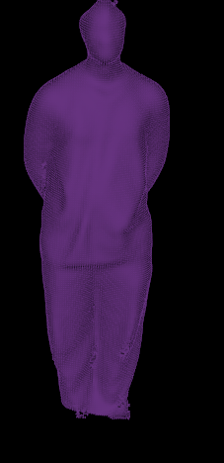
Grid Projection
SNIPET: pcl::GridProjection<pcl::PointNormal> gp; gp.setSearchMethod(kdtree Ptr); gp.setResolution(res);
gp.setPaddingSize(3);

Slide 35
Poisson Surface Reconstruction
Concept:
Combines local and global fitting methods.
Works best with noisy data points and can recover fine details
Reconstructs a water tight model by using Indicator function and extracting the isosurface.
Limitation:
Depends on the acquisition of the data points

Slide 36
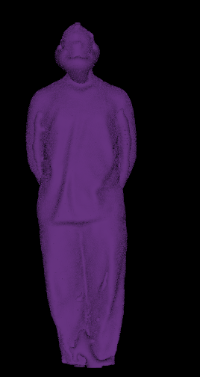
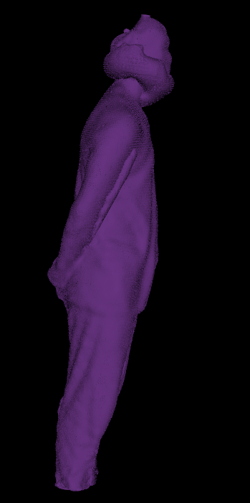
Poisson Reconstruction

Slide 37
Poisson code snipet
pcl::Poisson<pcl::PointNormal>poi;
poi.setDepth(12);
poi.setScale(1.2);
poi.setSolverDivide(8);
poi.setIsoDivide(8);
poi.setSamplesPerNode(2);

Slide 38
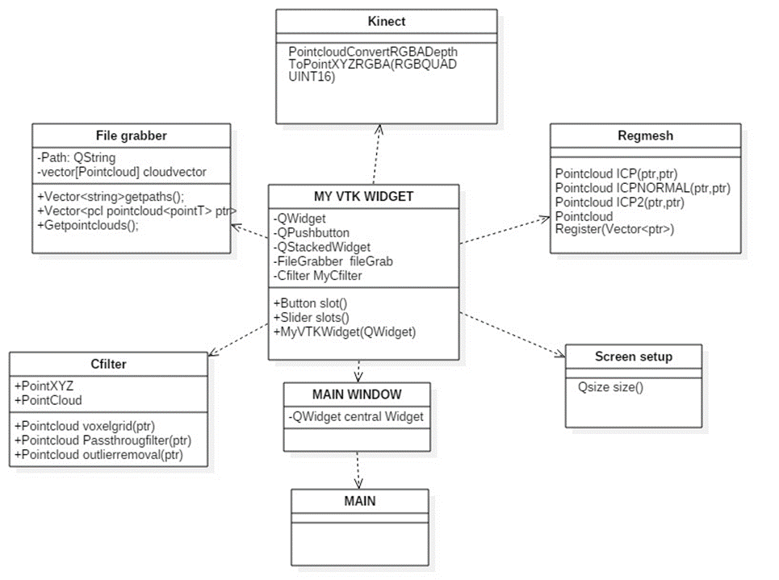
Class diagram

Slide 39
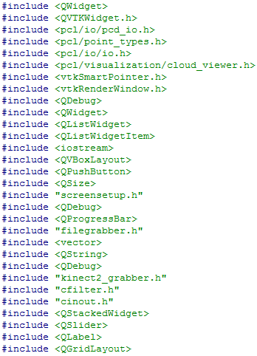
Qt CLASSES
Qwidget
QStackWidget
QListWidget
QGridLayout
Radiobutton
QVTKWidget

Slide 40
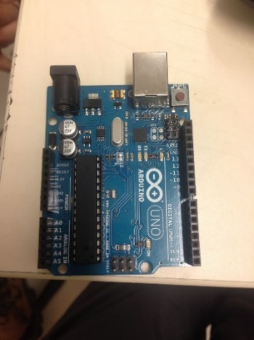
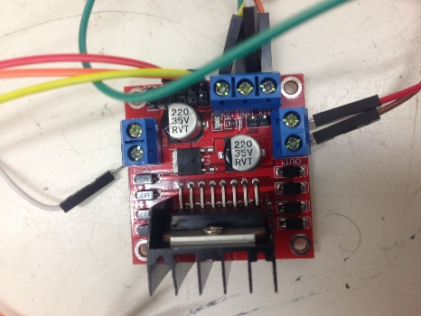
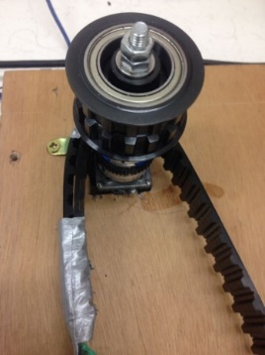
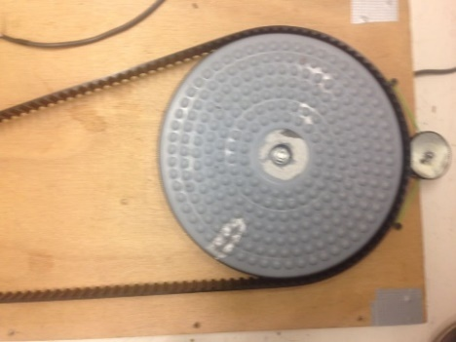
Turning Table (Hardware)
Power supply
Driver
DC motor
Driving belt
Twist board
Arduino board

Slide 41
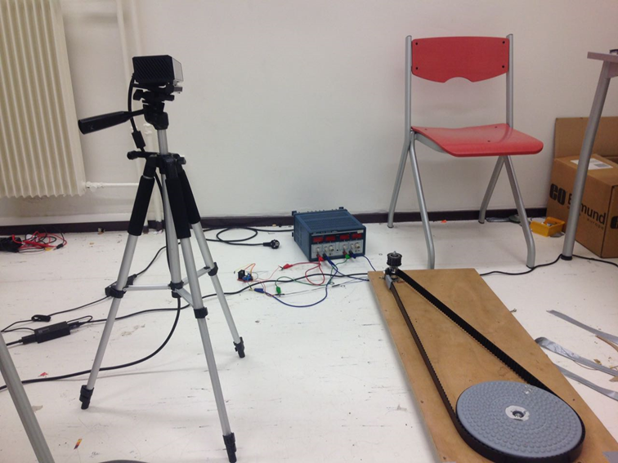
Turning Table (Serial Communication)
Using Qtserialport class to communicate Qt with Arduino board.
Arduino Sending PWM signal to control the DC motor.
In the function on_scanButton_clicked(), while scan push button is pressed, it will send the logic 1 to the board, the motor will start to rotate.
While the stop push button is pressed, it will send logic 0 to stop the motor.

Slide 42
Conclusion
What we have learned:
Understanding how to interact with Kinect V2(configuring pro.file and linking the library).
The basic idea and the pipeline of 3d point cloud reconstruction.
How we manage and organize this project in a big group(10 people).
How to use the PCL library functions and classes to fit in our project.
How to use Qt creator to build GUI.

